Slide 1
Extreme Value Analysis
The statistical analysis of low frequency, high severity events
Alfred J. Reich, PhD
20 October 2022

Slide 2
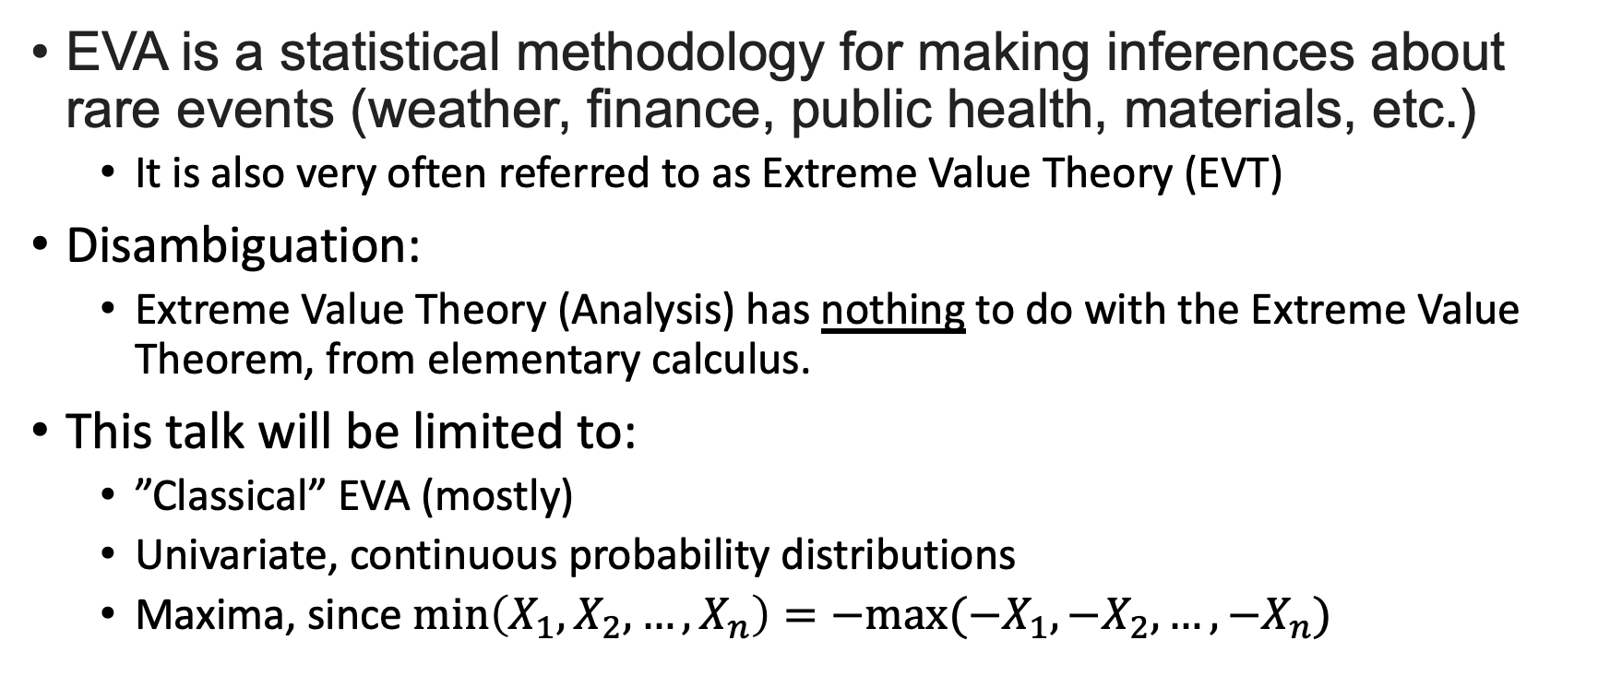
Extreme Value Analysis (EVA)
EVA is a statistical methodology for making inferences about rare events (weather, finance, public health, materials, etc.)
It is also very often referred to as Extreme Value Theory (EVT)
Disambiguation:
Extreme Value Theory (Analysis) has nothing to do with the Extreme Value Theorem, from elementary calculus.
This talk will be limited to:
”Classical” EVA (mostly)
Univariate, continuous probability distributions
Maxima, since $\min\left(X_{1},X_{2}, …, X_{n}\right)=−max⁡(−X_{1},{−X}_{2}, …,{−X}_{n})$

Slide 3
But isn’t “extrapolation” a Bad Thing?”
“But what EVT is doing is making the best use of whatever data you have about extreme phenomena.
… EVT cannot do magic - but it can do a whole lot better than empirical curve-fitting and guesswork
… if people aren’t given well-founded methods like EVT, they'll just use dubious ones instead.”
-- [Embrechts 1997]

Slide 4
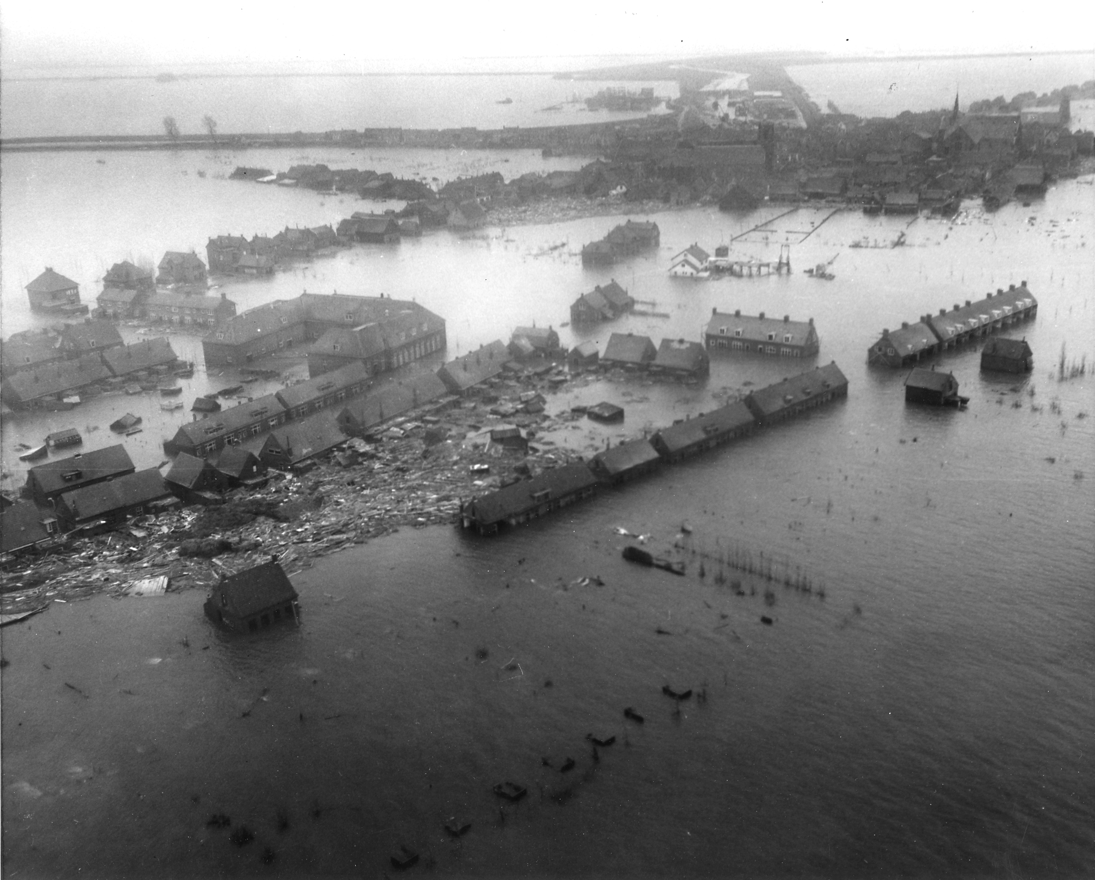
North Sea Flood of 1953
Losses:
1836 people killed
72,000 people evacuated
49,000 houses and farms flooded
201,000 cattle drowned
500 km coastal defenses destroyed
More than 200,000 ha flooded
Effect on Study of Extreme Events:
Very little systematic statistical research w.r.t. height of the dikes was done before 1953
Flood of 1570 was mean-sea-level + 4m
Gave EVA research a decisive push
Needed height estimate well outside range of existing data
Van Dantzig report estimated p=1-10⁻⁴ quantile (one-in-ten-thousand-year surge height) of mean-sea-level + 5.14m
Netherlands, during 1953 North Sea Flood.
Viewed from a U.S. Army helicopter.
Source: https://en.wikipedia.org/wiki/North_Sea_flood_of_1953
Source: [Embrechts 1997]

Slide 5
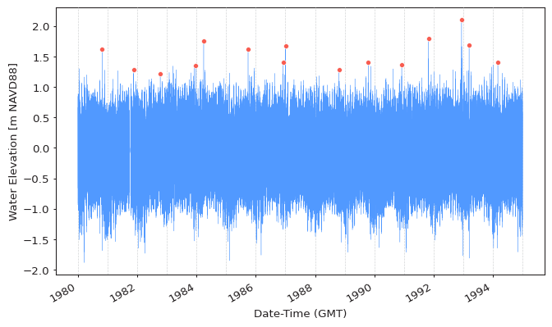
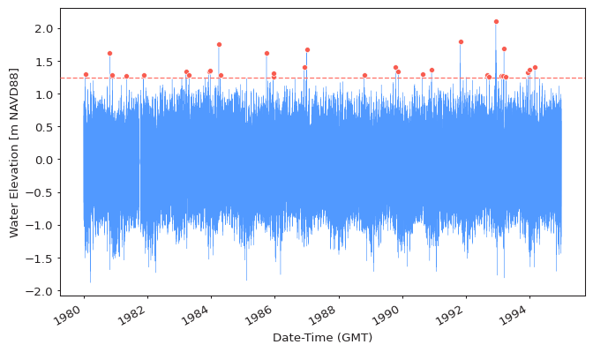
Two Primary Approaches to EVA
Block Maxima (BM)
Divide the data into large/long blocks and use the maximum/minimum value in each block
Points Over Threshold (POT)
Use all data that exceeds a specific threshold
Source: PyExtremes User Guide

Slide 6
A Very Brief Refresher
Probability Theory: PDFs, CDFs, CLT, etc.

Slide 7
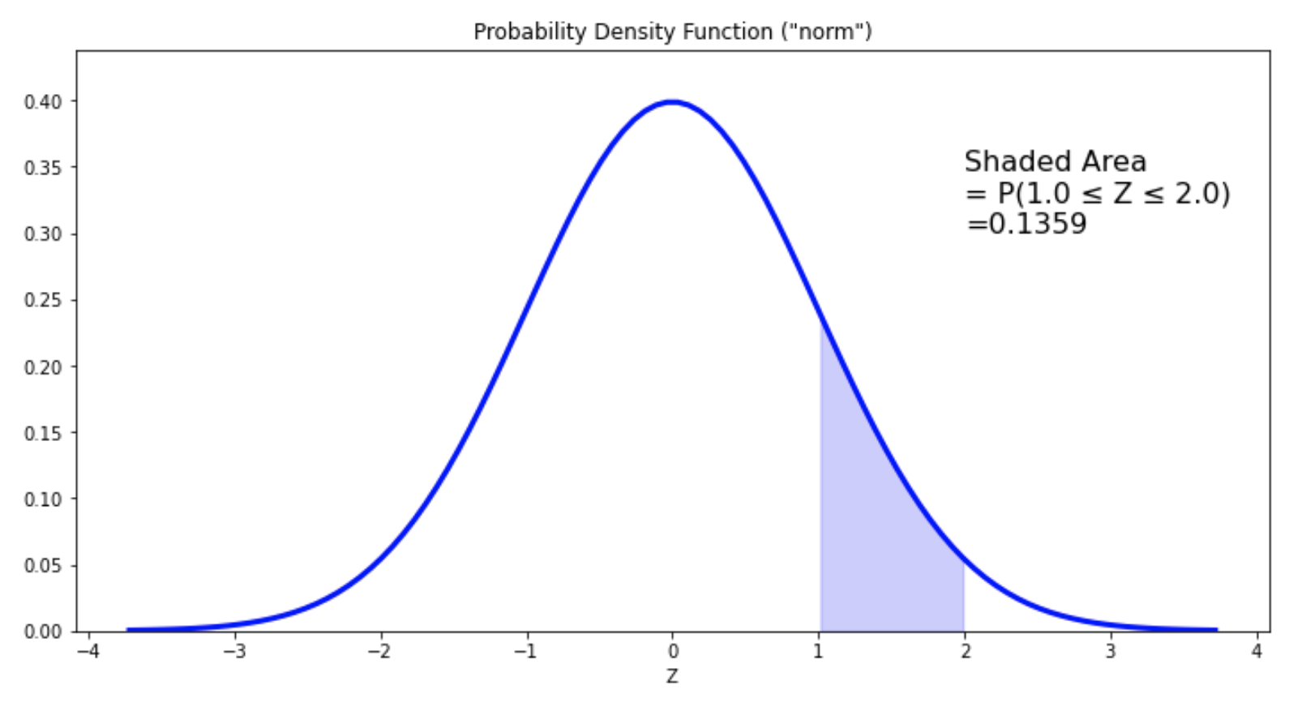
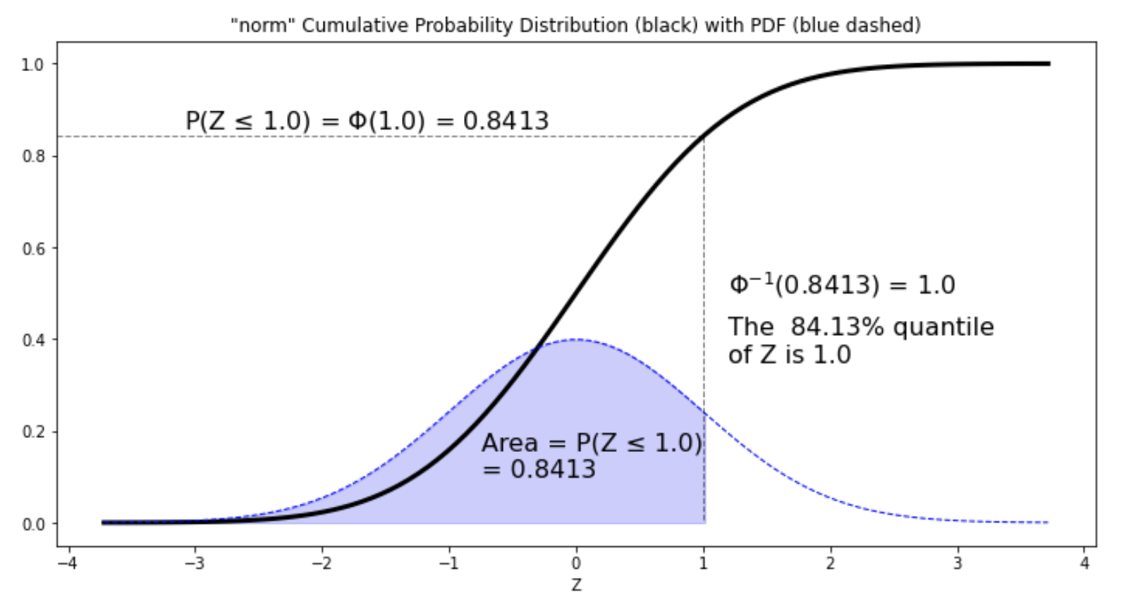
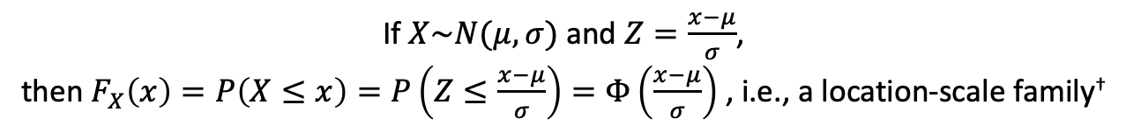
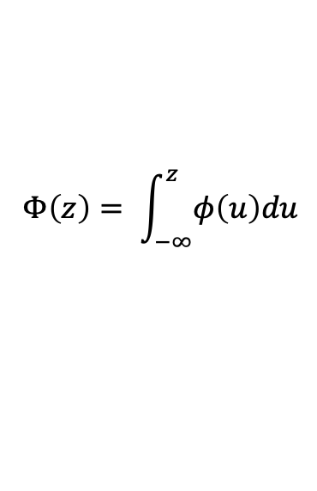
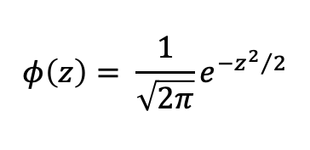
Continuous PDFs and CDFs
Standard Normal Distribution
Probability Density Function (PDF)
Cumulative Distribution Function (CDF)
$$φ\left(z\right)= \frac{1}{\sqrt{2π}}e^{−{z^{2}}/2}$$
$$Φ\left(z\right)= \int_{−∞}^{z}{φ\left(u\right)du}$$
If $X\sim N(μ,σ)$ and $Z=\frac{x−μ}{σ}$,
then $F_{X}\left(x\right)=P\left(X≤x\right)=P\left(Z≤\frac{x−μ}{σ}\right)=Φ\left(\frac{x−μ}{σ}\right)$ , i.e., a location-scale family†
†A location-scale family is a family of distributions formed by translation and scaling of a standard family member.

Slide 8
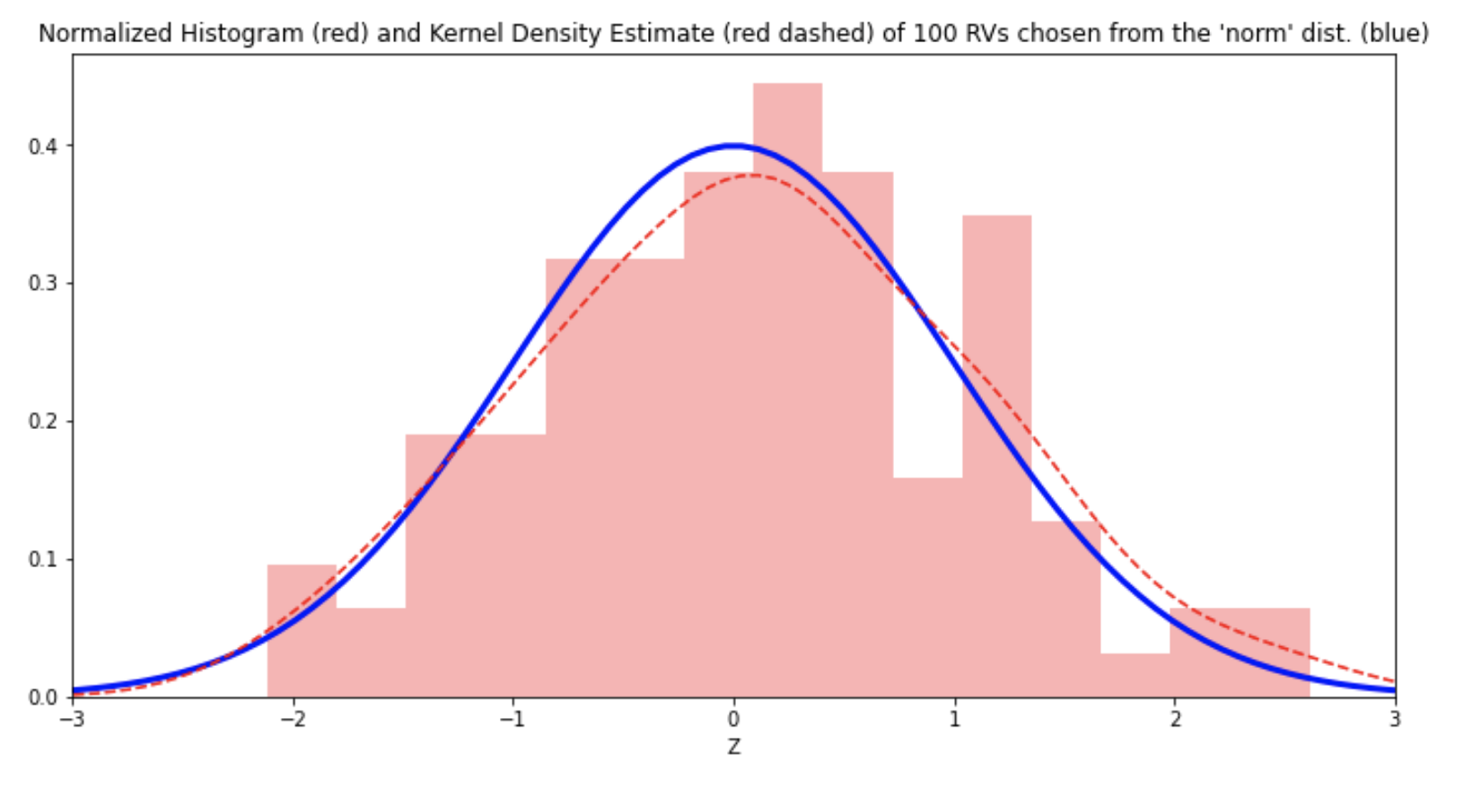
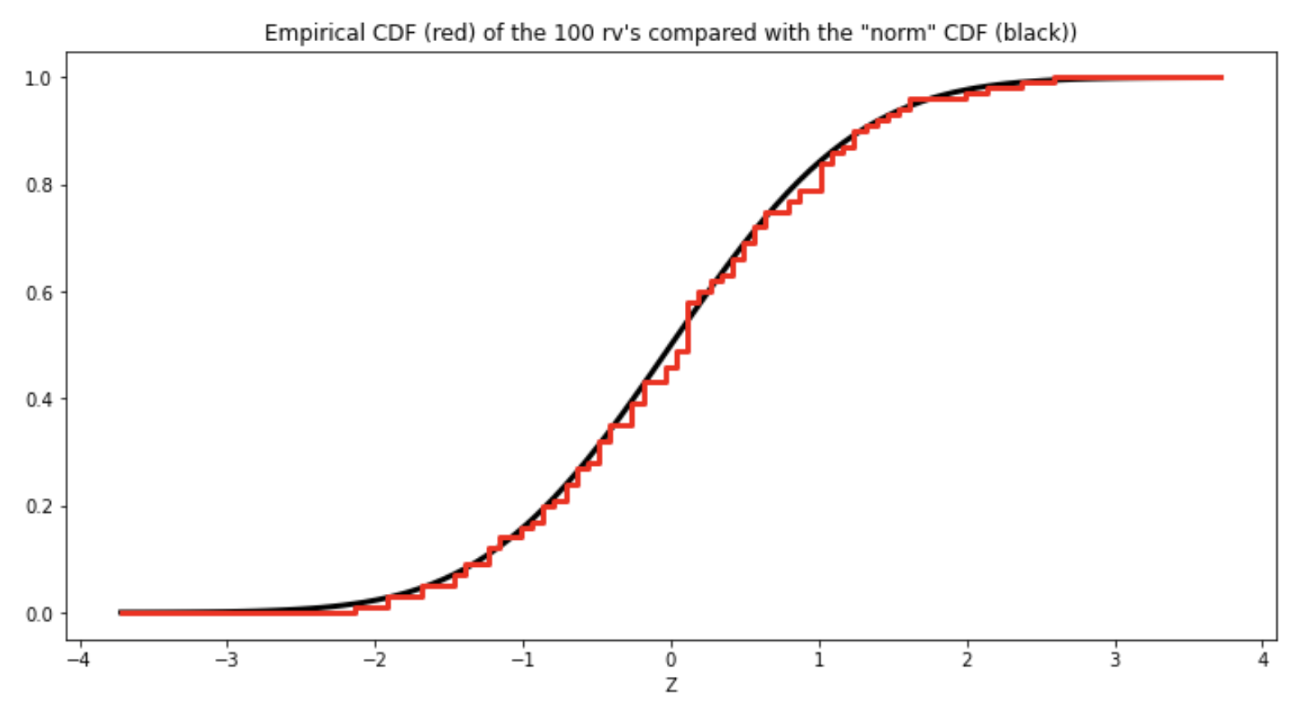
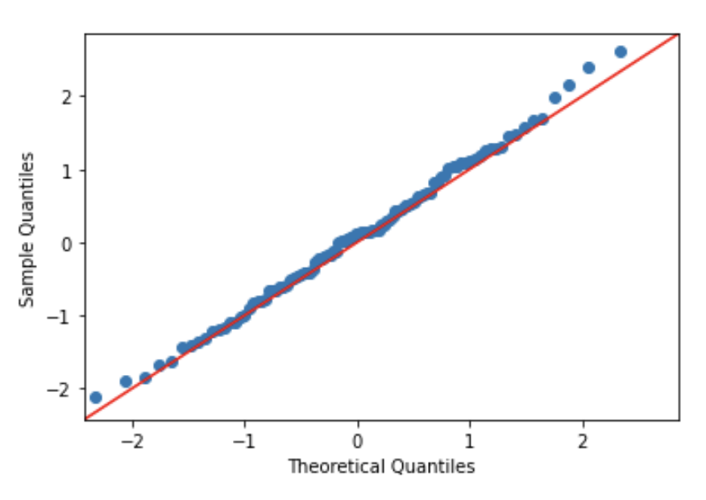
Histograms and Empirical CDFs
Normalized Histogram & Kernel Density Estimate
of a Random Sample
Empirical CDF of the Same Random Sample
QQ Plot
Histograms (normalized) are empirical estimates of PDFs, but their shape is sensitive to bin size
Kernel density estimates are another form of PDF estimate, but their shape is sensitive to the type of kernel used
The Empirical CDF is less susceptible to subjective choices,
so it is often used for model checking, for example, using Quantile-Quantile Plots.

Slide 9
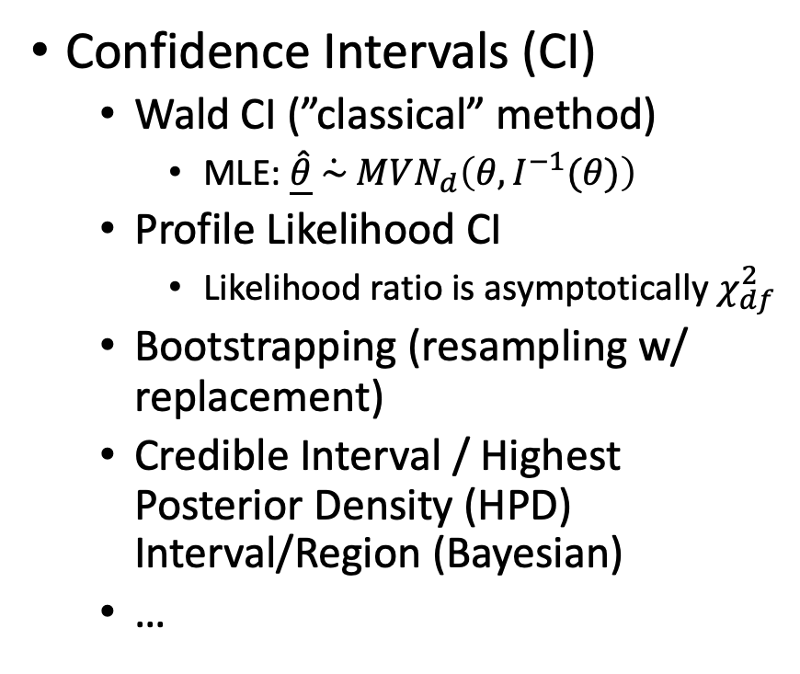
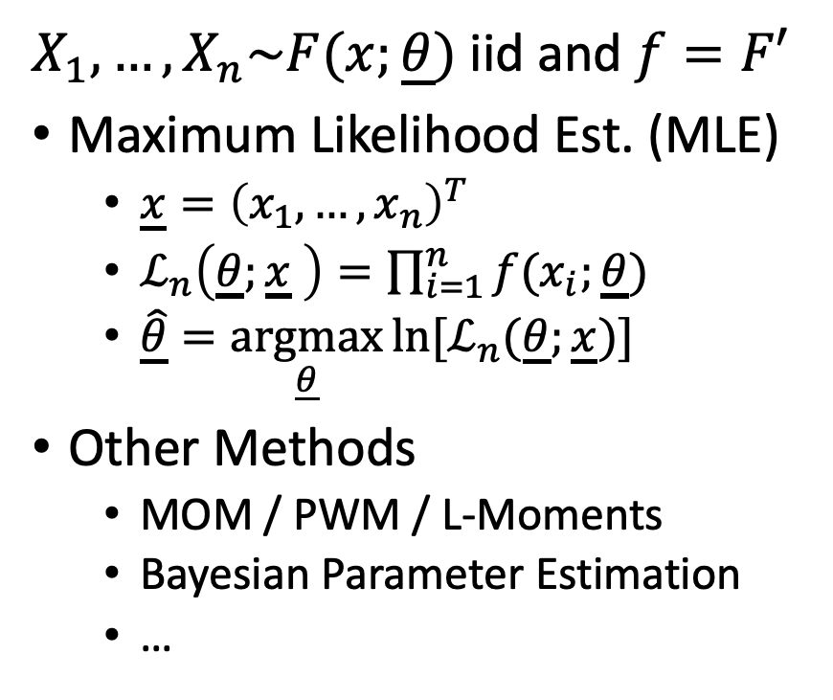
Parameter Estimation
$X_{1},…,X_{n}\sim F(x;\underline{θ})$ iid and $f=F′$
Maximum Likelihood Est. (MLE)
$\underline{x}={\left(x_{1},…,x_{n}\right)}^{T}$
$ℒ_{n}\left(\underline{θ};\underline{x} \right)=\prod_{i=1}^{n}{f(x_{i};\underline{θ})}$
$\hat{\underline{θ}}=\underset{\underline{θ}}{argmax}{{ln⁡[ℒ}_{n}(\underline{θ};\underline{x})]}$
Other Methods
MOM / PWM / L-Moments
Bayesian Parameter Estimation
…
Confidence Intervals (CI)
Wald CI (”classical” method)
MLE: $\hat{\underline{θ}}\dot{ \sim }MVN_{d}\left(θ, I^{−1}(θ)\right)$
Profile Likelihood CI
Likelihood ratio is asymptotically $χ_{df}^{2}$
Bootstrapping (resampling w/ replacement)
Credible Interval / Highest Posterior Density (HPD) Interval/Region (Bayesian)
…

Slide 10
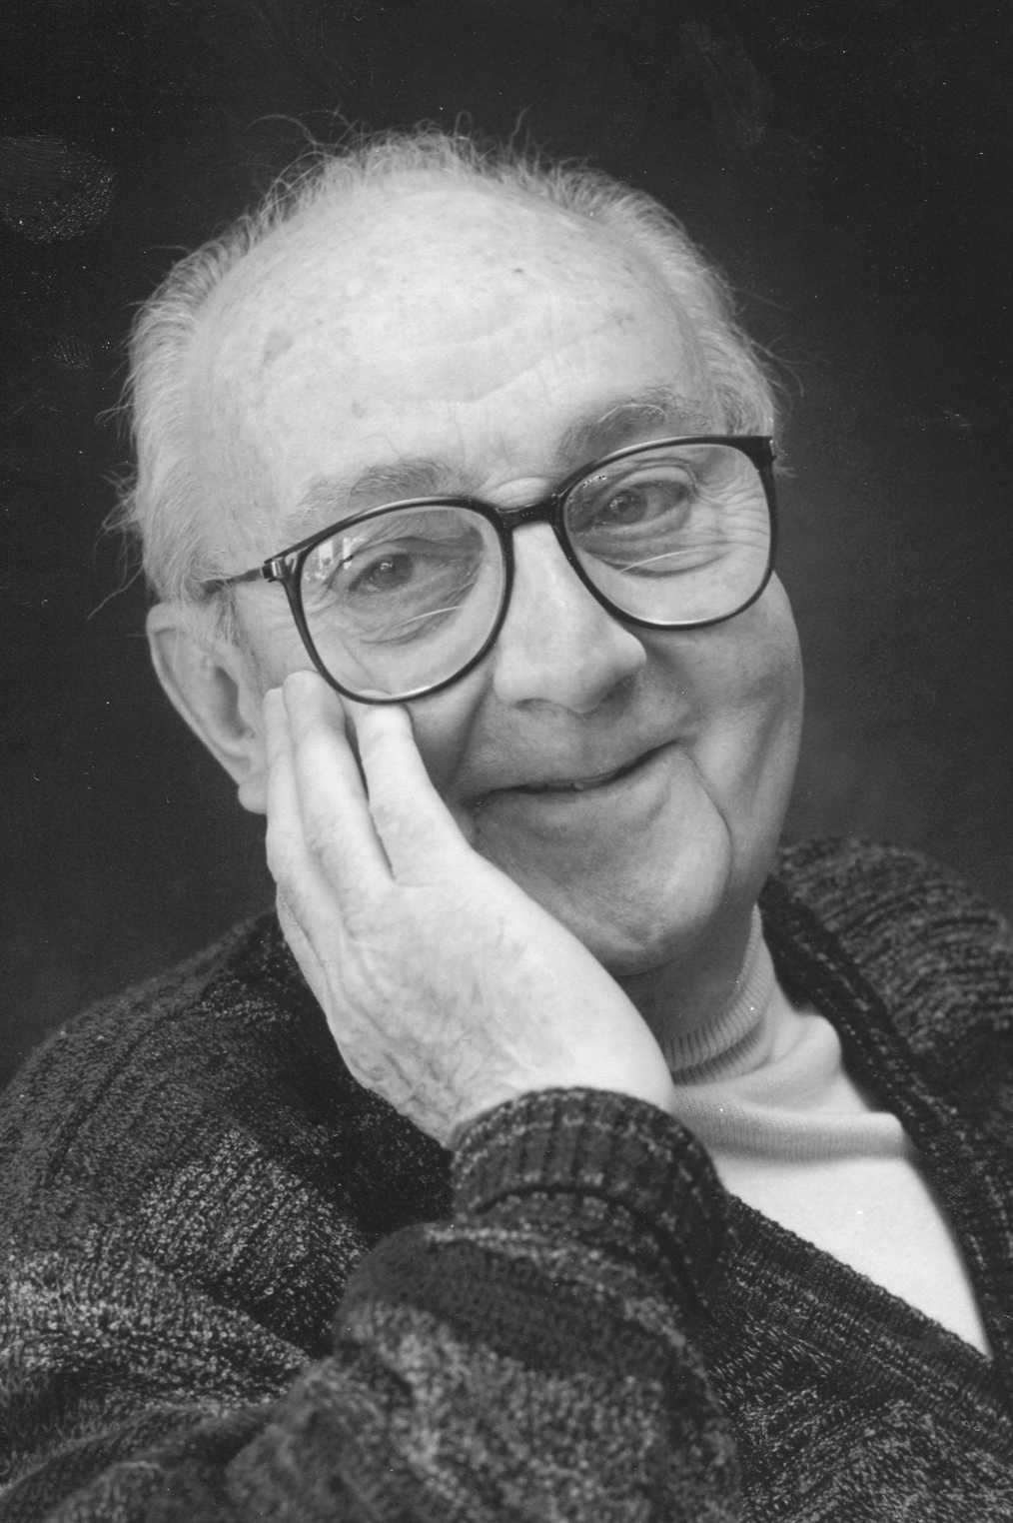
“All models are wrong, but some are useful”
-- George E. P. Box
By DavidMCEddy at en.wikipedia, CC BY-SA 3.0, https://commons.wikimedia.org/w/index.php?curid=115167166

Slide 11
Maximum Values
An experiment using pseudo-random numbers, along with some theory

Slide 12
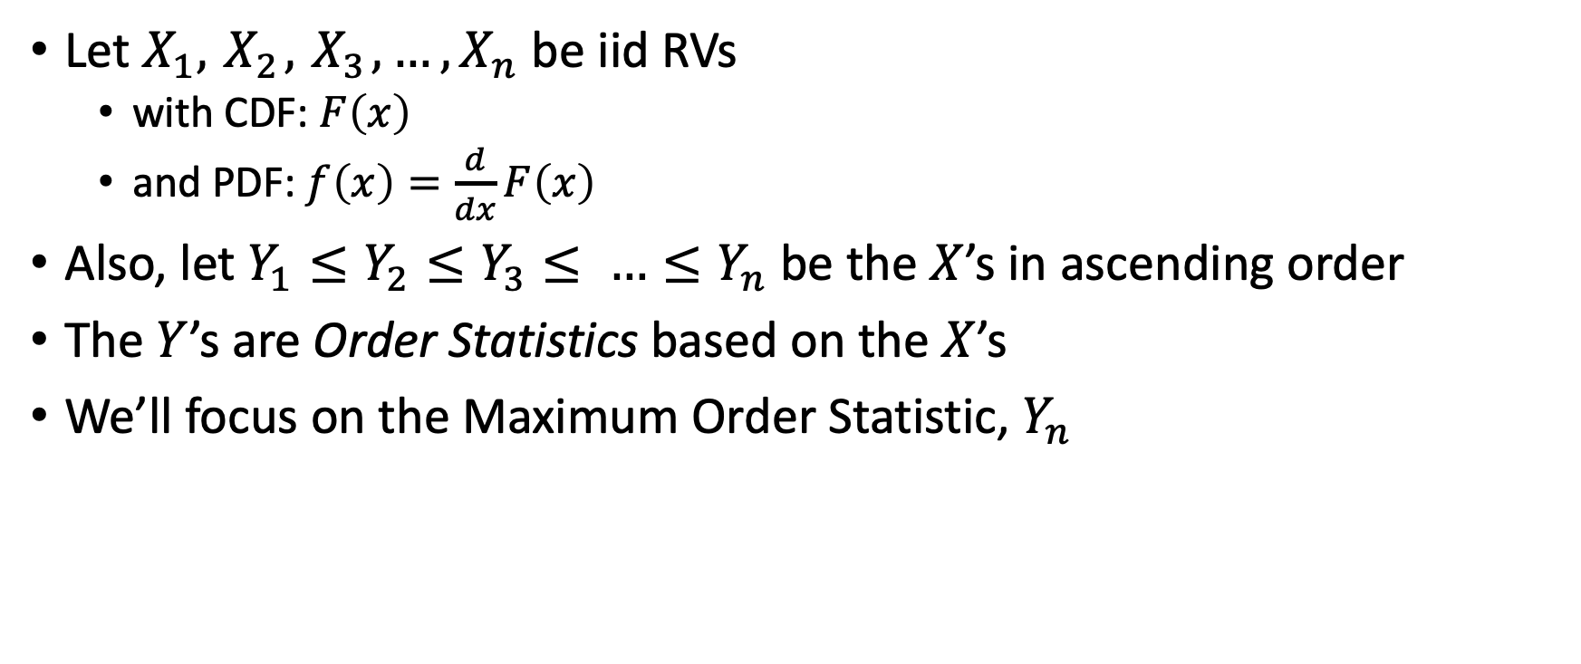
Order Statistics
Let $X_{1}, { X}_{2}, { X}_{3}, …, X_{n}$ be iid RVs
with CDF: $F\left(x\right)$
and PDF: $f\left(x\right)=\frac{d}{dx}F\left(x\right)$
Also, let $Y_{1}≤Y_{2}≤Y_{3}≤ …≤Y_{n}$ be the $X$’s in ascending order
The $Y$’s are Order Statistics based on the $X$’s
We’ll focus on the Maximum Order Statistic, $Y_{n}$

Slide 13
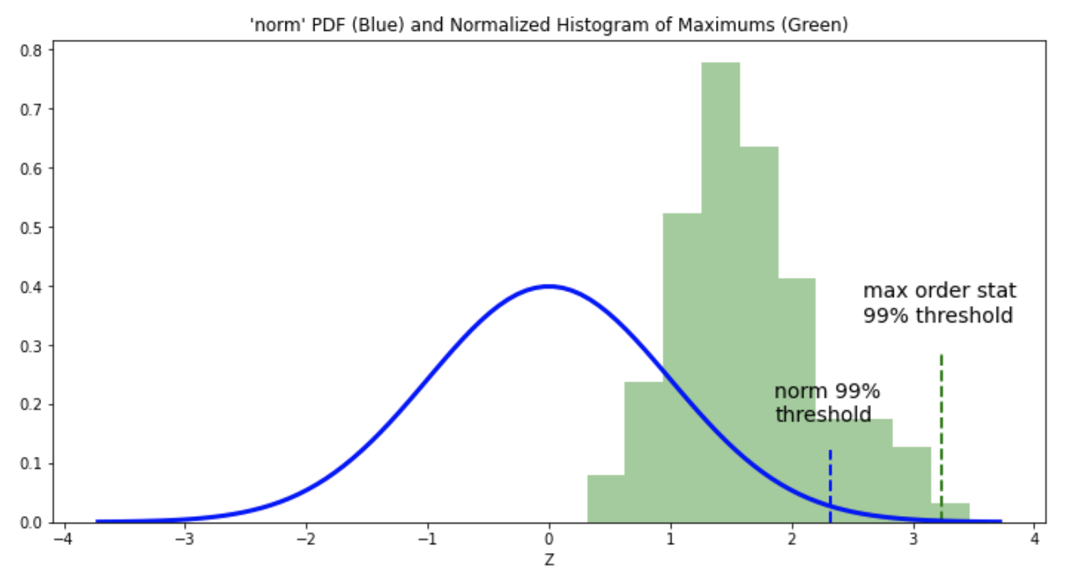
A Random Sample of Maximum Order Statistics (based on Std. Normal Dist.)
The figure at right depicts:
Standard Normal PDF (blue)
A normalized histogram of 200 maximum order statistics (green)
Where each maximum came from a random sample of 12 standard normal RVs
Two quantiles (“thresholds”):
Standard normal 99% quantile (~2.33)
Empirical 99% quantile of the 200 maxs (~3.24)
Note that there is almost a full N(0,1) standard deviation between the quantiles.

Slide 14
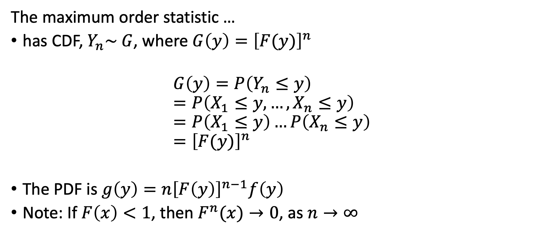
Distribution of the Maximum Order Statistic
The maximum order statistic …
has CDF, $Y_{n}\sim G$, where $G\left(y\right)={\left[F(y)\right]}^{n}$
$$G\left(y\right)=P\left(Y_{n}≤y\right) \\ =P\left(X_{1}≤y, …, X_{n}≤y\right) \\ =P\left(X_{1}≤y\right)…P\left(X_{n}≤y\right) \\ ={\left[F(y)\right]}^{n}$$
The PDF is $g\left(y\right)=n{\left[F\left(y\right)\right]}^{n−1}f\left(y\right)$
Note: If $F\left(x\right)<1$, then $F^{n}(x)→0$, as $n→∞$

Slide 15
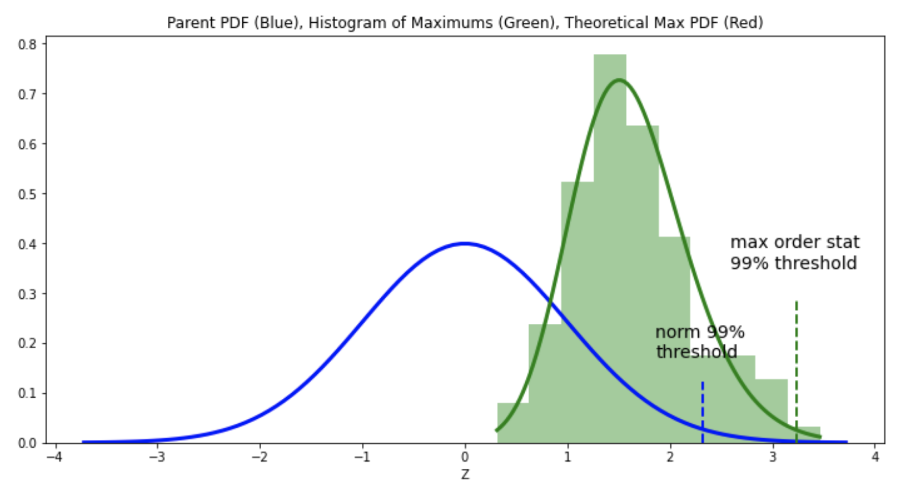
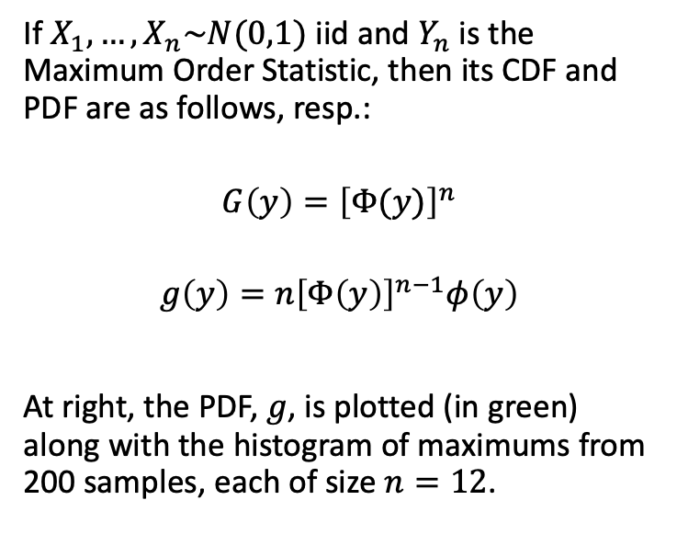
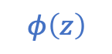

Max. Order Stat. Distribution (based on Std. Normal Dist.)
If $X_{1},…,X_{n}\sim N(0,1)$ iid and $Y_{n}$is the Maximum Order Statistic, then its CDF and PDF are as follows, resp.:
$$G\left(y\right)={\left[Φ(y)\right]}^{n}$$
$$g\left(y\right)=n{\left[Φ\left(y\right)\right]}^{n−1}φ\left(y\right)$$
At right, the PDF, $g$, is plotted (in green) along with the histogram of maximums from 200 samples, each of size $n=12$.
$$g(z)=12{\left[Φ\left(z\right)\right]}^{11}φ\left(z\right)$$
$$φ\left(z\right)$$

Slide 16
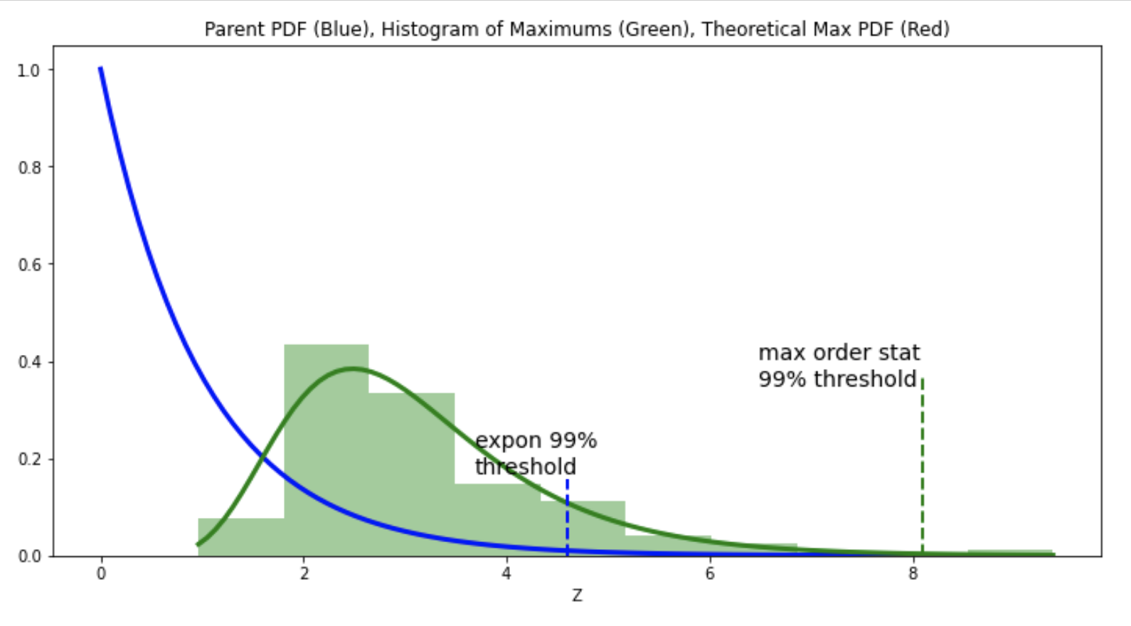
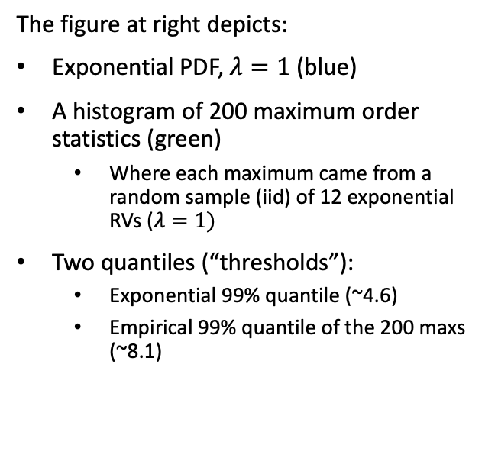
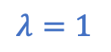
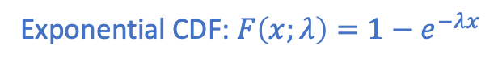
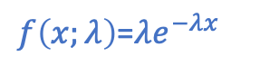
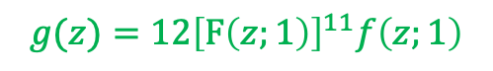
Max. Order Stat. Distribution (based on Exponential Dist.)
The figure at right depicts:
Exponential PDF, $λ=1$ (blue)
A histogram of 200 maximum order statistics (green)
Where each maximum came from a random sample (iid) of 12 exponential RVs ($λ=1)$
Two quantiles (“thresholds”):
Exponential 99% quantile (~4.6)
Empirical 99% quantile of the 200 maxs (~8.1)
$f\left(x;λ\right)$=$λe^{−λx}$
$$λ=1$$
Exponential CDF: $F\left(x;λ\right)=1−e^{−λx}$
$$g(z)=12{\left[F\left(z;1\right)\right]}^{11}f\left(z;1\right)$$

Slide 17
Extreme Value Theory (EVT)
The Generalized Extreme Value (GEV) Distribution and Theorem

Slide 18
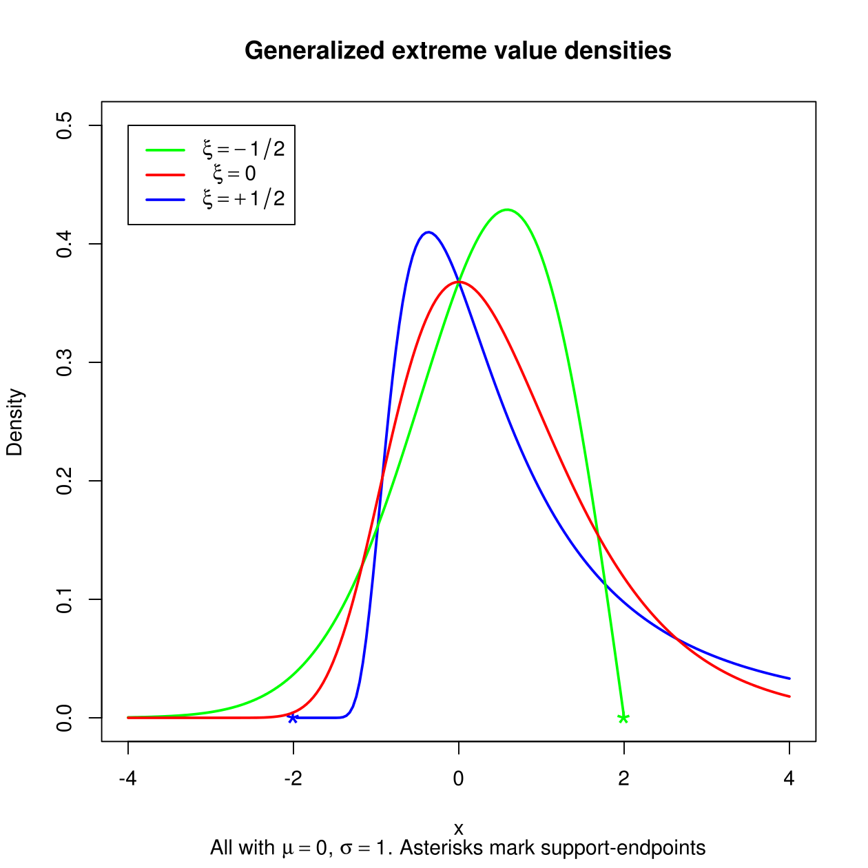
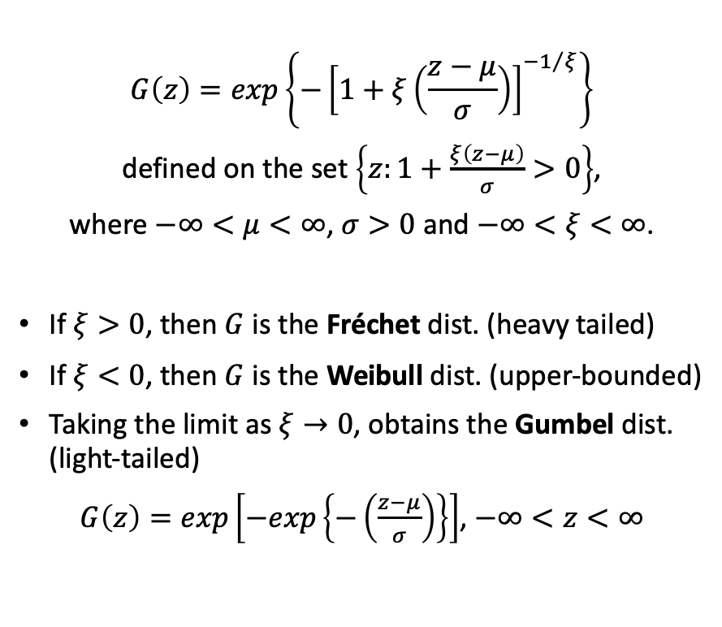
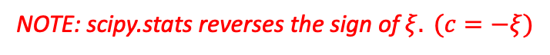
Generalized Extreme Value (GEV) Distribution
CDF
PDFs
$$G\left(z\right)=exp\left\{−{\left[1+ξ\left(\frac{z−μ}{σ}\right)\right]}^{{−1}/ξ}\right\}$$
defined on the set $\left\{z:1+\frac{ξ\left(z−μ\right)}{σ}>0\right\}$,
where $−∞<μ<∞$, $σ>0$ and $−∞<ξ<∞$.
If $ξ>0$, then $G$ is the Fréchet dist. (heavy tailed)
If $ξ<0$, then $G$ is the Weibull dist. (upper-bounded)
Taking the limit as $ξ→0$, obtains the Gumbel dist. (light-tailed)
$G\left(z\right)=exp\left[−exp\left\{−\left(\frac{z−μ}{σ}\right)\right\}\right]$, $−∞<z<∞$
Source: [Coles 2001]
NOTE: scipy.stats reverses the sign of $ξ. (c=−ξ)$
Source: [Wikipedia: GEV]

Slide 19
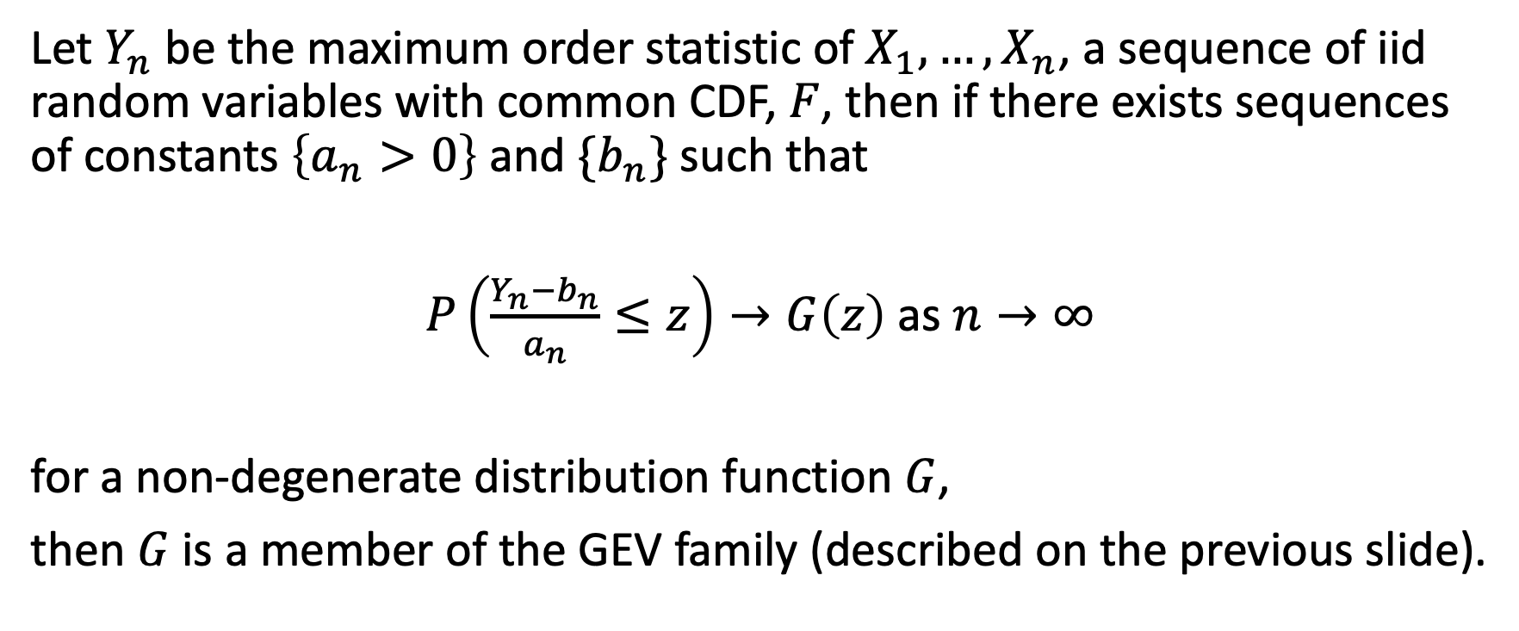
Extreme Value Theorem
Let $Y_{n}$ be the maximum order statistic of $X_{1},…,X_{n}$, a sequence of iid random variables with common CDF, $F$, then if there exists sequences of constants $\left\{a_{n}>0\right\}$ and $\{b_{n}\}$ such that
$P\left(\frac{Y_{n}−b_{n}}{a_{n}}≤z\right)→G\left(z\right)$ as $n→∞$
for a non-degenerate distribution function $G$,
then $G$ is a member of the GEV family (described on the previous slide).

Slide 20
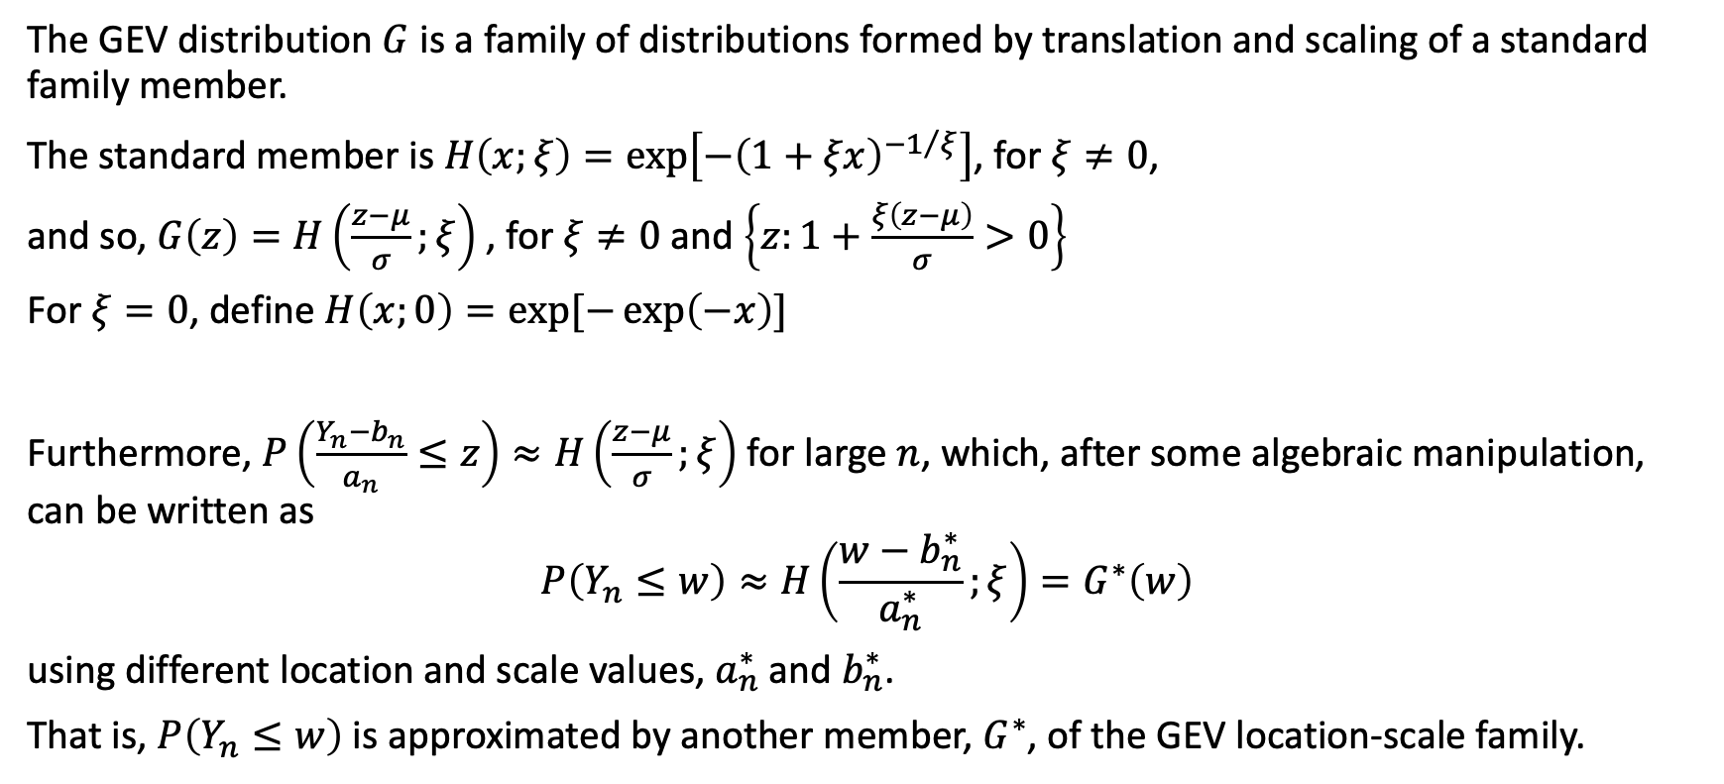
GEV is a Location-Scale Family of Distributions
The GEV distribution $G$ is a family of distributions formed by translation and scaling of a standard family member.
The standard member is $H\left(x;ξ\right)=exp\left[−{\left(1+ξx\right)}^{{−1}/ξ}\right]$, for $ξ≠0$,
and so, $G\left(z\right)=H\left(\frac{z−μ}{σ};ξ\right)$ , for $ξ≠0$ and $\left\{z:1+\frac{ξ\left(z−μ\right)}{σ}>0\right\}$
For $ξ=0$, define $H\left(x;0\right)=exp⁡[−\exp\left(−x\right)]$
Furthermore, $P\left(\frac{Y_{n}−b_{n}}{a_{n}}≤z\right)≈H\left(\frac{z−μ}{σ};ξ\right)$ for large $n$, which, after some algebraic manipulation, can be written as
$$P\left(Y_{n}≤w\right)≈H\left(\frac{w−b_{n}^{∗}}{a_{n}^{∗}};ξ\right)=G^{∗}\left(w\right)$$
using different location and scale values, $a_{n}^{∗}$ and $b_{n}^{∗}$.
That is, $P\left(Y_{n}≤w\right)$ is approximated by another member, $G^{∗}$, of the GEV location-scale family.

Slide 21
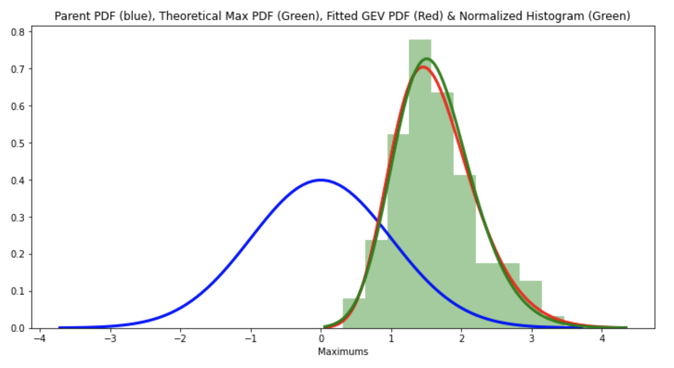
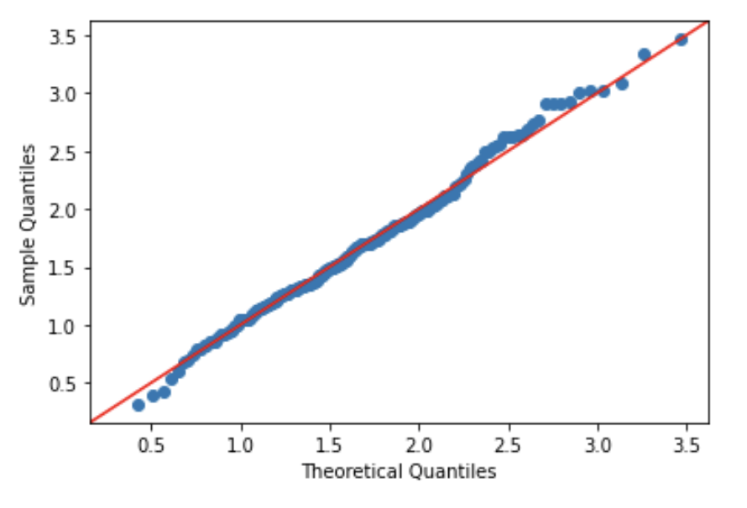
GEV MLE Fit to Maximums based on Std. Normal RVs
Same as earlier normal plot, except that now the GEV fit (via MLE) is also shown (red)
The QQ-plot shows the normal-based maximums (data) vs. the GEV fit

Slide 22
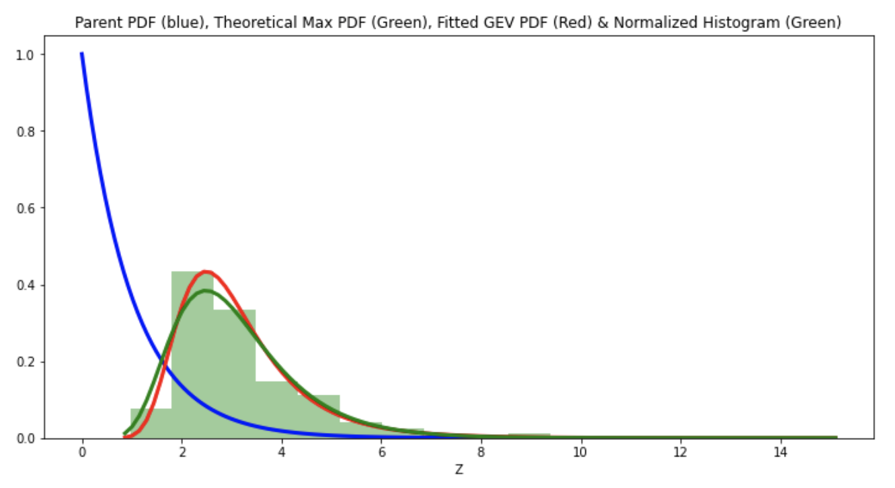
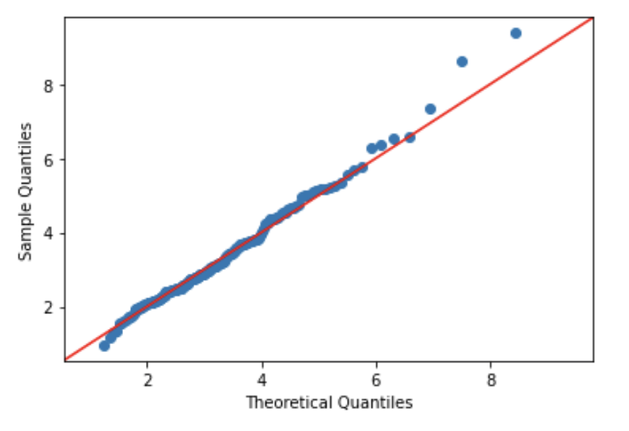
GEV MLE Fit to Maximums based on Exponential RVs
Same as earlier exponential plot, except that now the GEV fit (via MLE) is also shown (red)
The QQ-plot shows the exponential-based maximums (data) vs. the GEV fit

Slide 23
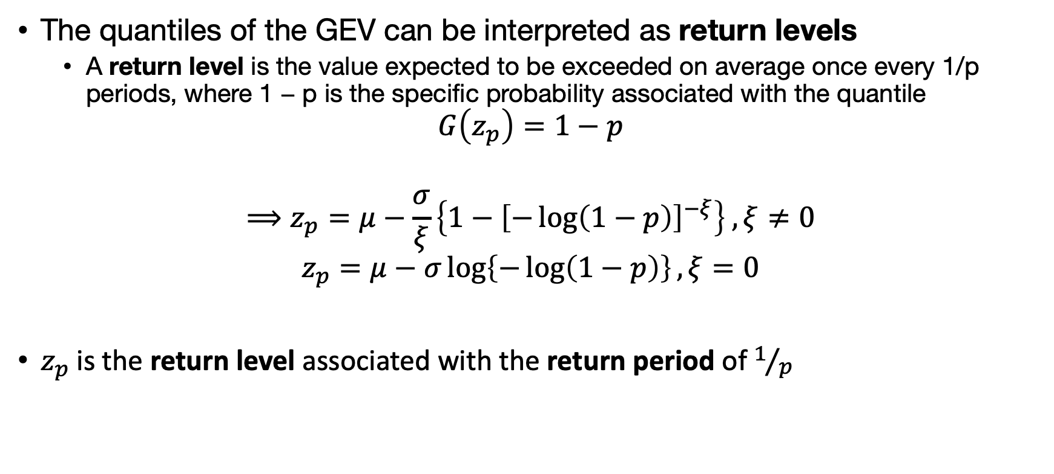
Return Levels & Return Periods
The quantiles of the GEV can be interpreted as return levels
A return level is the value expected to be exceeded on average once every 1/p periods, where 1 − p is the specific probability associated with the quantile
$$G\left(z_{p}\right)=1−p$$
$$⟹z_{p}=μ−\frac{σ}{ξ}\left\{1−{\left[−\log\left(1−p\right)\right]}^{−ξ}\right\} , ξ≠0$$
$$z_{p}=μ−σ\log\left\{−\log\left(1−p\right)\right\}, ξ=0$$
$z_{p}$ is the return level associated with the return period of $1/p$

Slide 24
Example 1
GEV Fit using ISMEV (R)

Slide 25
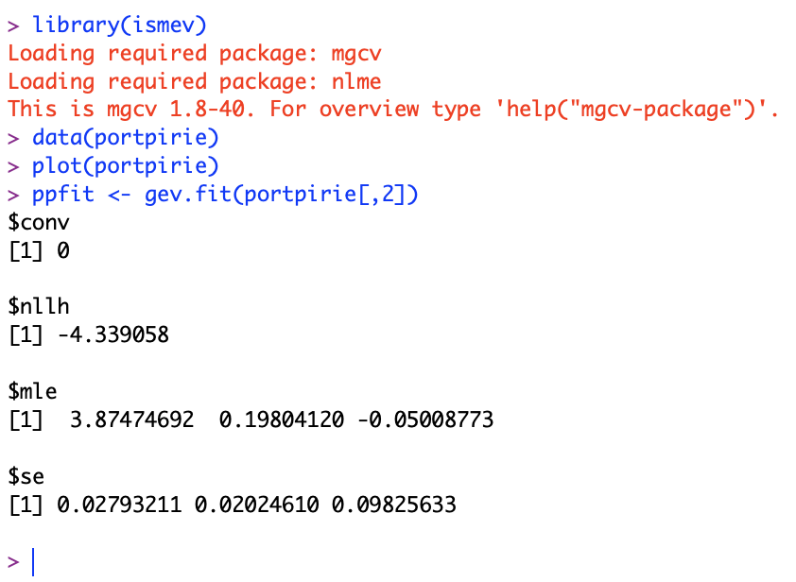
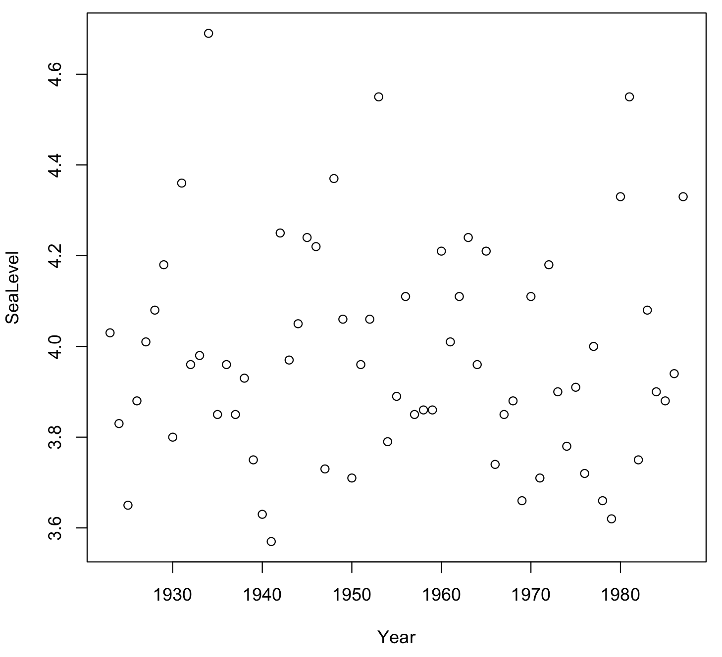


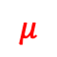
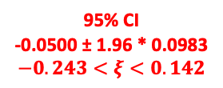
Example 1: ismev (R)
Annual Maximum Sea-Levels at Port Pirie, South Australia
Information, derived during the MLE fit, is stored here.
$$μ$$
$$σ$$
$$ξ$$
95% CI
-0.0500 ± 1.96 * 0.0983
$$−0.243<ξ<0.142$$

Slide 26
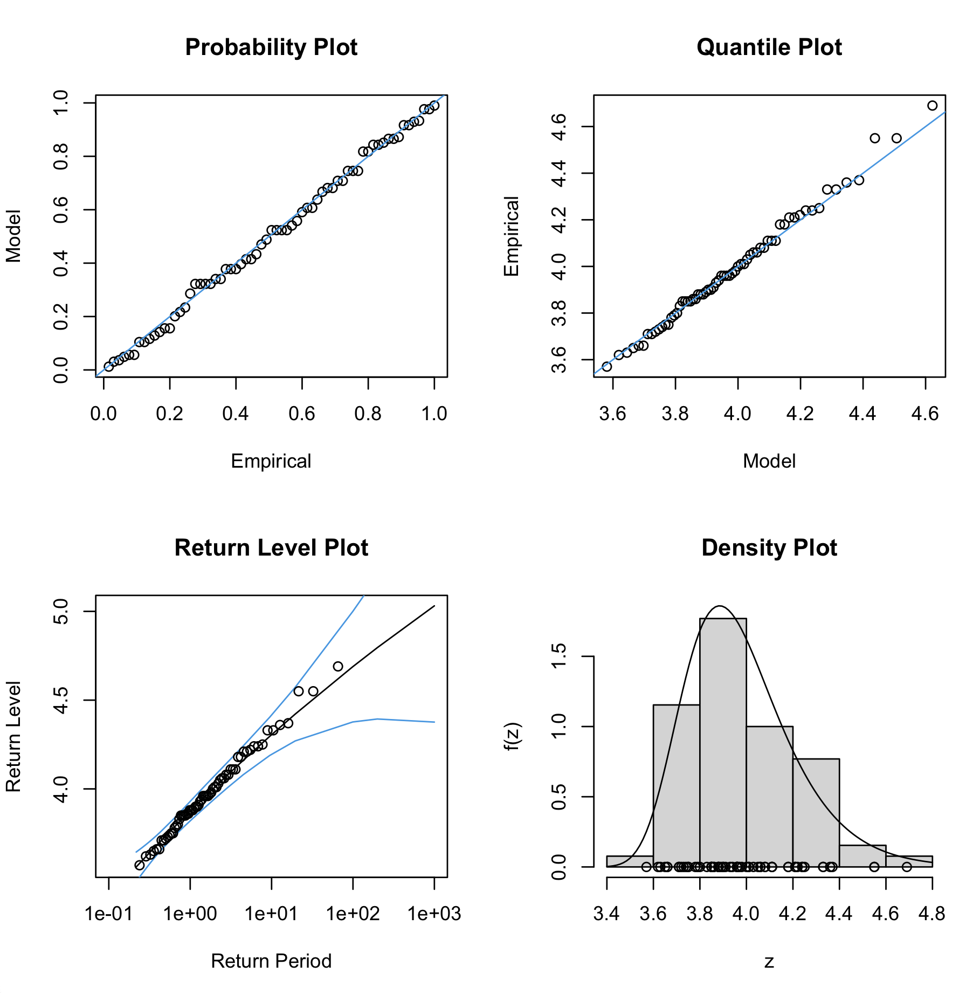
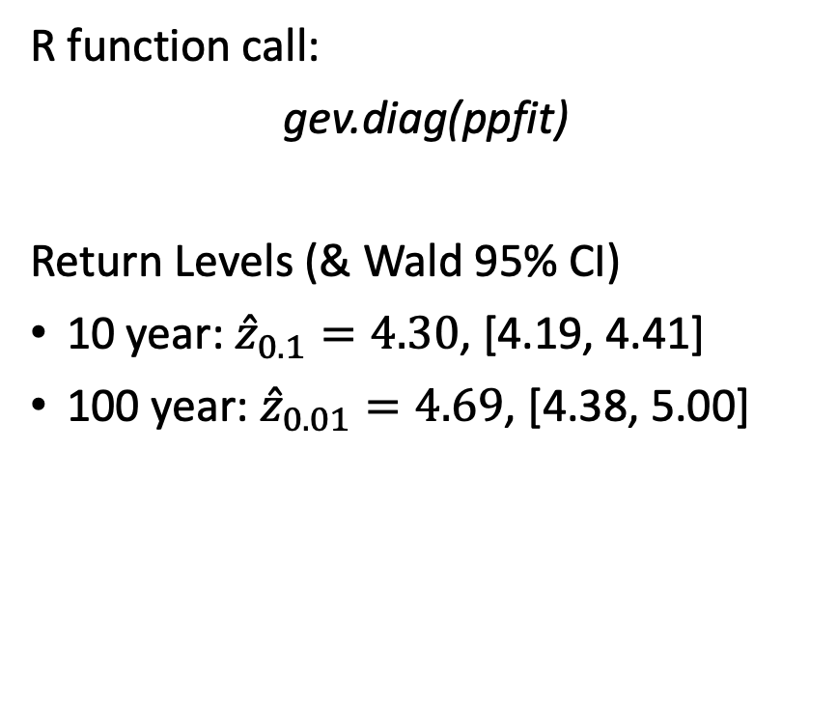
Example 1: Diagnostics
R function call:
gev.diag(ppfit)
Return Levels (& Wald 95% CI)
10 year: ${\hat{z}}_{0.1}=4.30$, [4.19, 4.41]
100 year: ${\hat{z}}_{0.01}=4.69$, [4.38, 5.00]

Slide 27
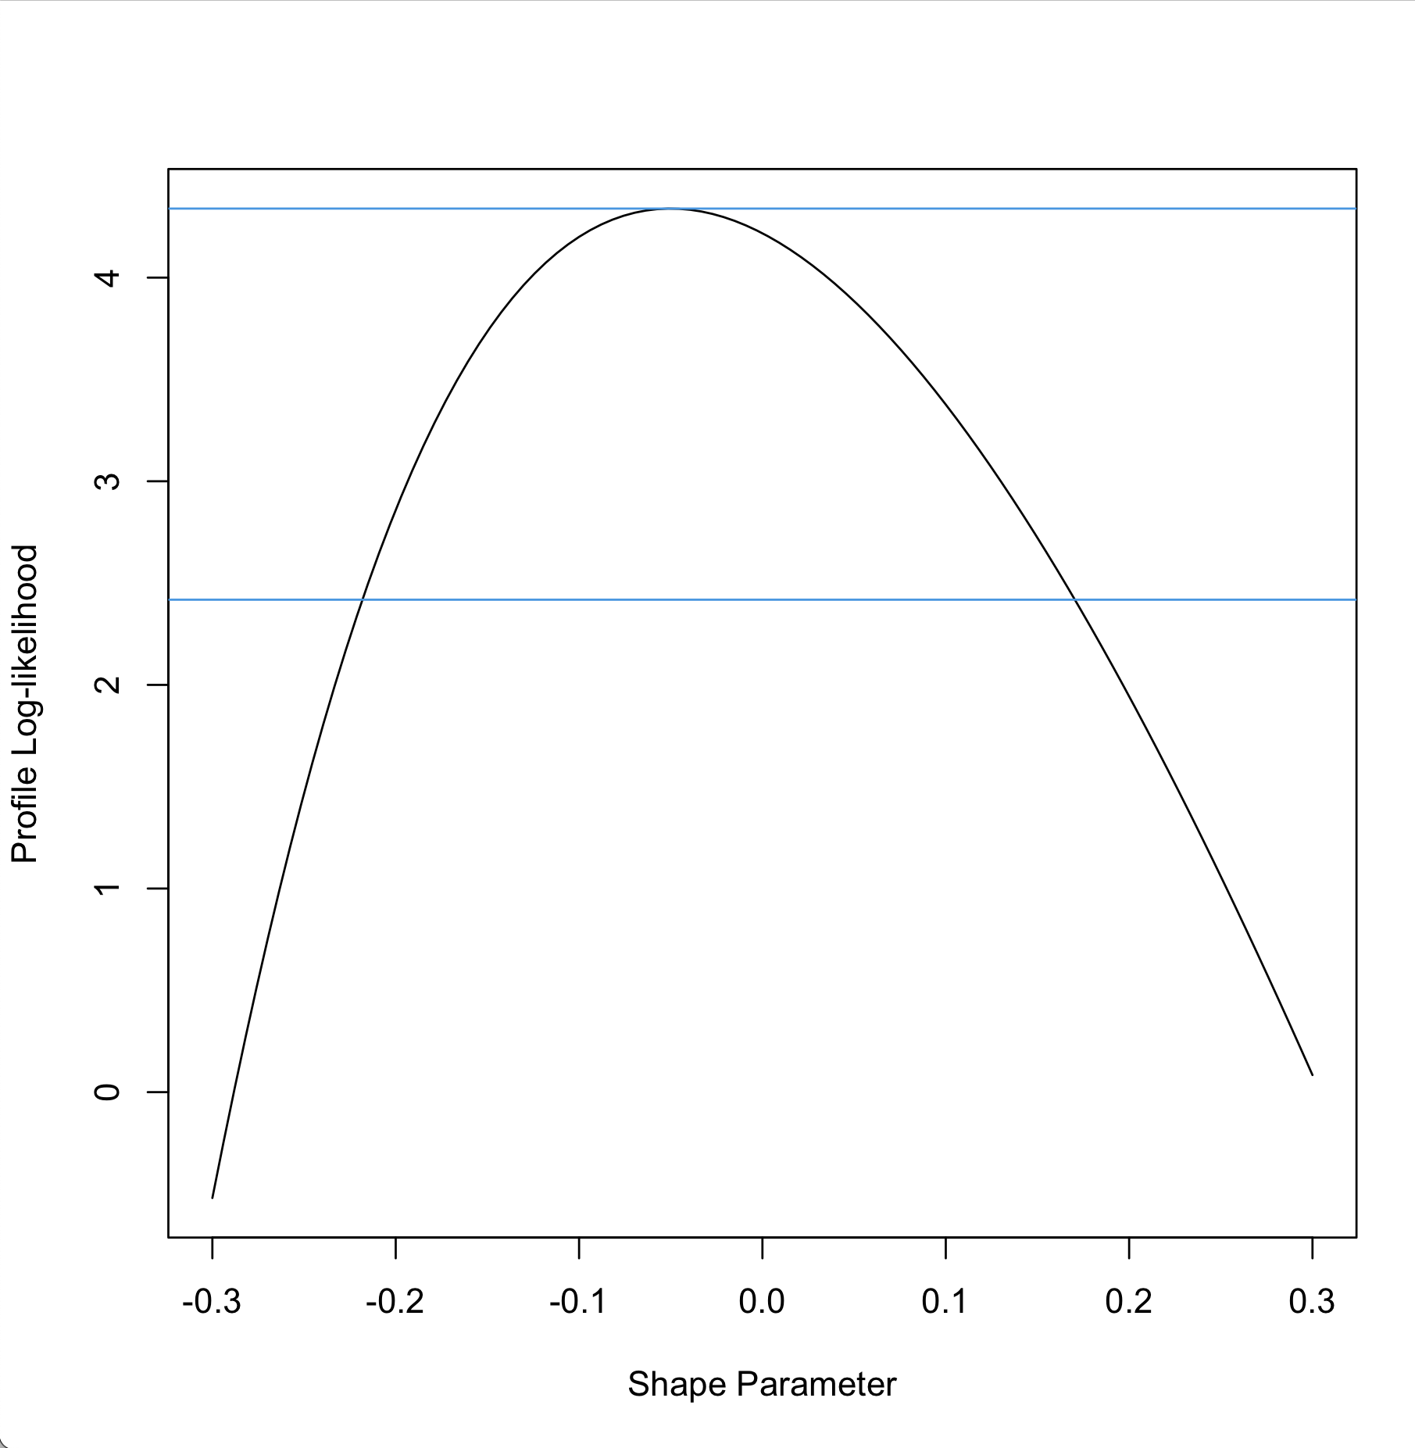

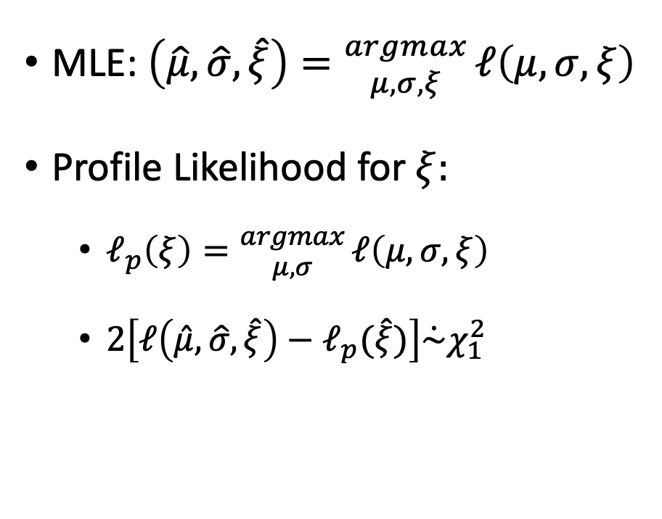
Example 1: Profile Likelihood
STILL NEEDS WORK
gev.profxi(ppfit, -0.3, 0.3)
MLE: $\left(\hat{μ},\hat{σ},\hat{ξ}\right)={argmax \atop μ,σ,ξ}ℓ\left(μ,σ,ξ\right)$
Profile Likelihood for $ξ:$
$ℓ_{p}\left(ξ\right)={argmax \atop μ,σ}ℓ\left(μ,σ,ξ\right)$
$2\left[ℓ\left(\hat{μ},\hat{σ},\hat{ξ}\right)−ℓ_{p}(\hat{ξ})\right]\dot{\sim }χ_{1}^{2}$
95%
[-0.21, 0.17]
$$ξ$$

Slide 28
Peaks Over Threshold (POT)
and the Generalized Pareto Distribution (GPD)

Slide 29
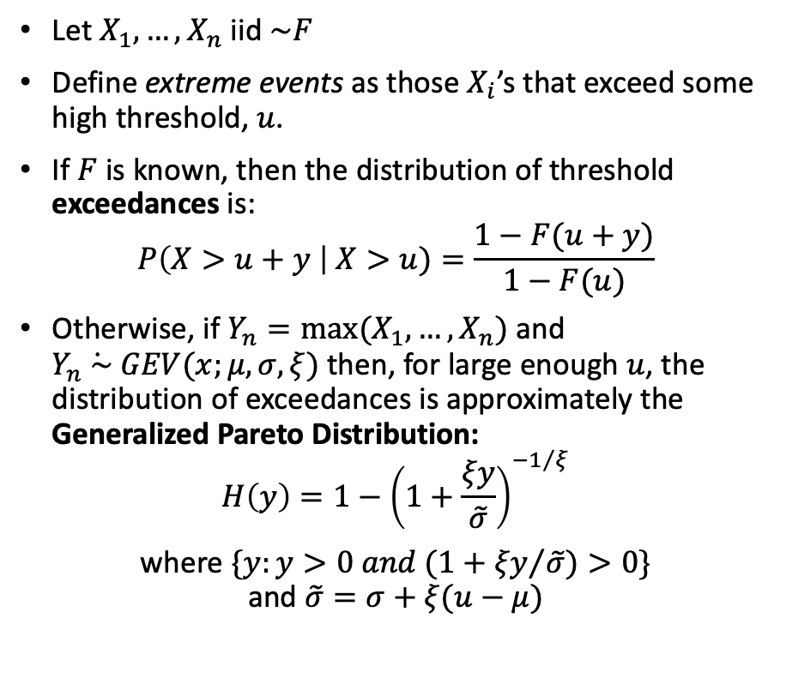
Peaks Over Threshold (POT) & the Generalized Pareto Distribution (GPD)
Let $X_{1},…,X_{n}$ iid $\sim F$
Define extreme events as those $X_{i}$’s that exceed some high threshold, $u$.
If $F$ is known, then the distribution of threshold exceedances is:
$$P\left(X>u+y \right| X>u)=\frac{1−F(u+y)}{1−F(u)}$$
Otherwise, if $Y_{n}=max⁡(X_{1},…,X_{n})$ and $Y_{n}\dot{ \sim } GEV(x;μ,σ,ξ)$ then, for large enough $u$, the distribution of exceedances is approximately the Generalized Pareto Distribution:
$$H\left(y\right)=1−{\left(1+\frac{ξy}{\tilde{σ}}\right)}^{{−1}/ξ}$$
where $\{y:y>0 and (1+{ξy}/{\tilde{σ})>0\}}$ and $\tilde{σ}=σ+ξ(u−μ)$

Slide 30
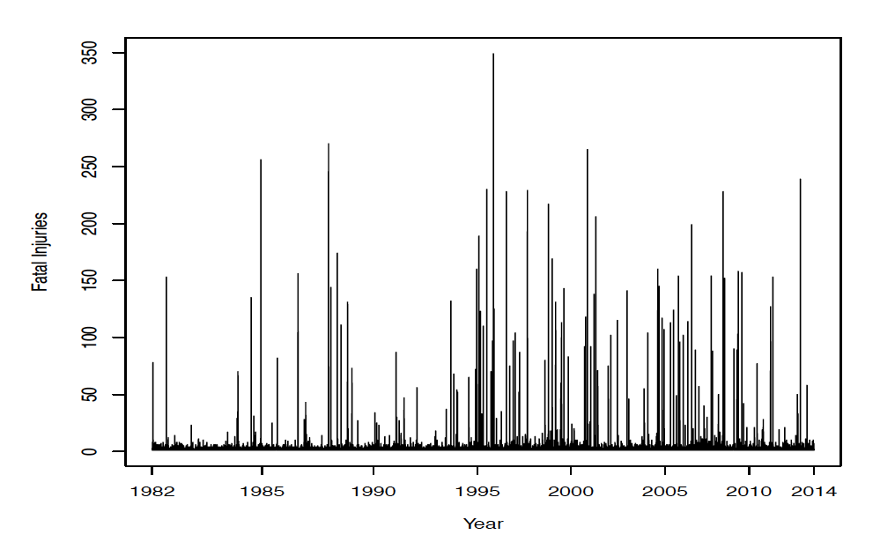
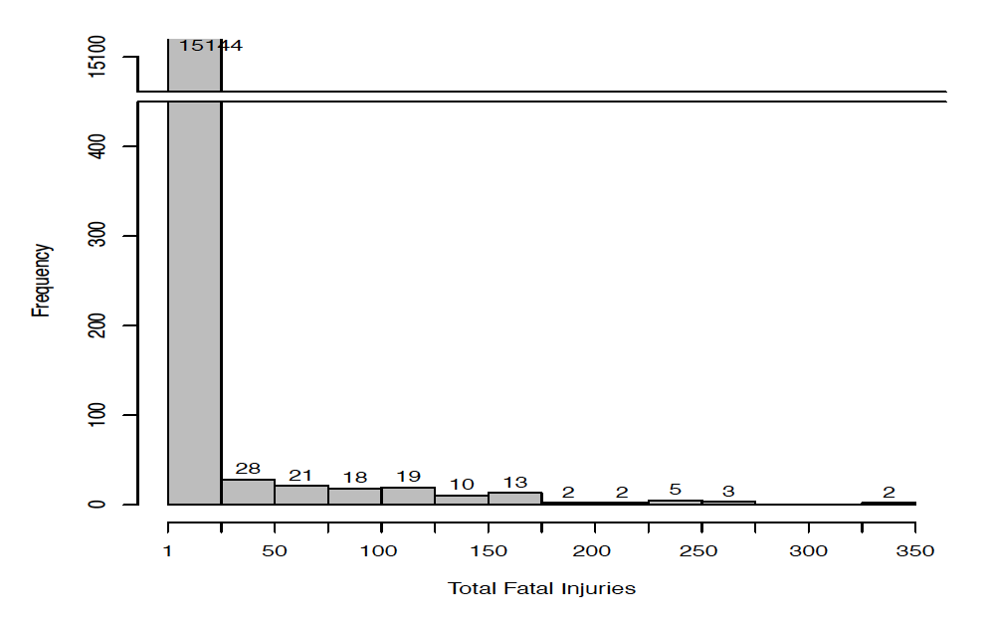
Choosing a Threshold for POT: Example
Fatal Injuries from Aviation Accidents
“Quantification of the large accidents which have far reaching effect (fatality) would provide objective guidance in long-term planning and response for manufacturers, insurers and re-insurers.” [Das 2016]
Numbers of fatal injuries from aviation accidents, 1982 - 2014
Histogram of fatal injuries from aviation accidents
Source: [Das 2016]

Slide 31
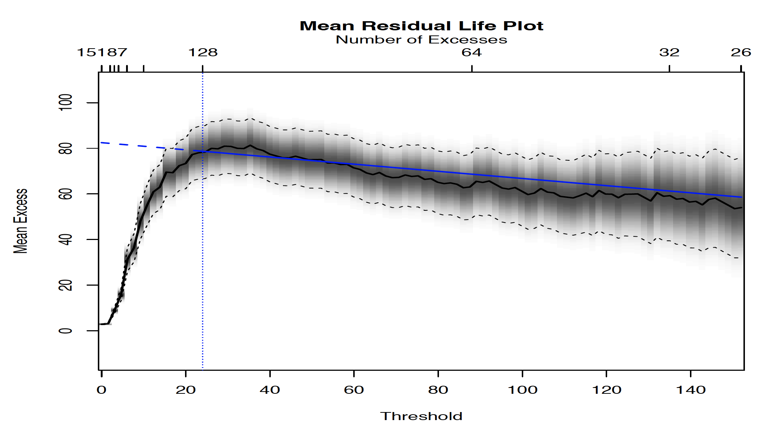
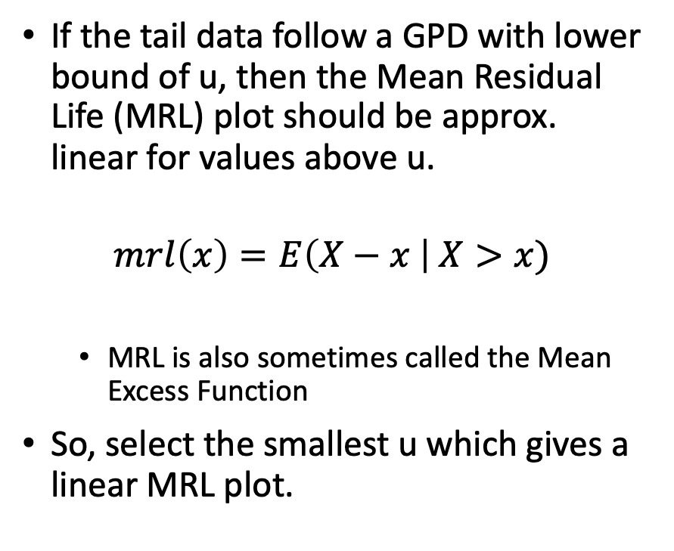
Choosing a Threshold for POT: MRL
If the tail data follow a GPD with lower bound of u, then the Mean Residual Life (MRL) plot should be approx. linear for values above u.
$$mrl\left(x\right)=E\left(X−x \right| X>x)$$
MRL is also sometimes called the Mean Excess Function
So, select the smallest u which gives a linear MRL plot.
Source: [Das 2016]

Slide 32

Choosing a Threshold for POT: Parameter Stability

Slide 33
Stationarity & Non-Stationarity

Slide 34


Stationarity
$X_{1},X_{2},…$ is a stationary random process if for any set of integers $\left\{i_{1},…,i_{k}\right\}$ and any integer $m$, the joint distributions of $(X_{i_{1}},…,X_{i_{k}})$ and $\left(X_{i_{1}+m},…,X_{i_{k}+m}\right)$ are identical.
https://en.wikipedia.org/wiki/Stationary_process

Slide 35

Dealing with Non-Stationarity
Data often contains trends and seasonal cycles (financial, weather)
Using BM with annual maximums can avoid seasonal cycles (weather)
Trends and cycles can be removed via regression or time-series modeling.
Example from extRemes
[Gilliland 2016]

Slide 36


Dealing with Non-Stationarity (cont.)
Financial Application: Estimate VaR (Value-at-Risk) for a given portfolio
S&P 500 Closing Values
Daily % Returns
Transformations can be used on data to obtain stationarity
For example, differencing or taking logarithms of ratios of successive observations can approximate stationarity (e.g., log-daily returns in finance)
Source: [Beirlant 2004]

Slide 37
Example 2
GEV Fit using PyExtremes (Python)

Slide 38

Example 2: pyextremes (Python)
Water Levels for the Battery Station in New York
Raw Data (.csv) read & ”cleaned”
Sorted in ascending order
NaN entries removed
Converted to Pandas.Series
https://pandas.pydata.org/
Trend removed (+2.87 mm/yr)
> from pyextremes import EVA
> model = EVA(data)
EVA class provides interface to pyextremes library
> model.get_extremes(method="BM", block_size="365.2425D")
> model.plot_extremes()
See https://pypi.org/project/pyextremes/

Slide 39

Example 2: pyextremes (Model Fit)
> model.fit_model()

Slide 40


Example 2: pyextremes (Model Summary)

Slide 41

Example 2: pyextremes (Diagnostic Plots)
> model.plot_diagnostic(alpha=0.95)

Slide 42

Example 2: pyextremes (Return Values Plot)
> model.plot_return_values(
return_period=np.logspace(0.01, 2, 100),
return_period_size="365.2425D",
alpha=0.95,
)

Slide 43
BM or POT?
We cannot say that one method is better than another
Different models and approaches (correctly applied) should converge to the same answer (within reasonable limits)
So, investigate both
BM is a simpler and more stable model
Requires very little input from the user
Use BM with a reasonable block size to avoid capturing seasonality
Get the initial estimates and see how the extremes behave
Use POT with a reasonable threshold and declustering
To see how well the model behaves near the target return periods
and to gain more confidence in the results
Source: PyExtremes User Guide

Slide 44
EVA Software
R:
ismev: https://cran.r-project.org/web/packages/ismev/index.html
extRemes: https://cran.r-project.org/web/packages/extRemes/index.html
and many, many more… see the following…
https://cran.r-project.org/web/views/ExtremeValue.html (Many links to other EVA packages in R)
“A modeler’s guide to extreme value software”, Belzile, et al., arXiv:2205.07714v1, 16 May 2022
Python:
Pyextremes: https://georgebv.github.io/pyextremes/
Scikit-extremes: https://kikocorreoso.github.io/scikit-extremes/
Wafo: https://pypi.org/project/wafo/

Slide 45
Case Studies (in brief)
Solar Flares, California Droughts, and Human Life Span

Slide 46

“EVA of Solar Flare Events” [Tsiftsi 2018]
1859 – the “Carrington Event” (X45), most intense geomagnetic storm in recorded history
Est. cost to U.S. of similar event: $670 billion to $2.9 trillion (~ 3.6% – 15.5% annual GDP)
https://en.wikipedia.org/wiki/Carrington_Event#Similar_events
Return Period: 110 years,
with profile likelihood CI ∼ (20, 6500) years.
Probability of a Carrington-like event happening in the next decade is 9%
2003 – “Halloween solar storms” (X35) generated largest solar flare ever recorded by GOES
Return Period: 38 years,
with profile likelihood CI ∼ (10, 300) years.
A Halloween-like event is expected in the next decade with probability 23.8%

Slide 47

California Droughts [Robeson 2015]
The 1-year 2014 drought was most severe in the 1895–2014 record
Has a return period of 140–180 years,
however, quantile mapping produces return periods of 700–900 years
Cumulative 3- and 4-year droughts are estimated to be much more severe
2012–2014 drought is nearly a 10,000-year event
2012–2015 drought has an almost incalculable return period and is completely without precedent
PDSI – Palmer Drought Severity Index

Slide 48


Limits to Human Life Span [Einmahl 2019]
Used EVA to consider whether the human life span is bounded:
30 years of data from Dutch residents
The estimated extreme value indices ($ξ$), exhibited in Figure 2, at right, are all negative, hinting at a finite upper endpoint, that is, a finite maximum life span.

Slide 49
References
[Beirlant 2004] J. Beirlant, et al., “Statistics of Extremes: Theory and Applications” (2004)
[Belzile 2022] Belzile, et al., “A modeler’s guide to extreme value software”, arXiv:2205.07714v1 (2022)
[Coles 2001] S. Coles, “An Introduction to Statistical Modeling of Extreme Values”, Springer (2001)
[Das 2016] K. Das & A. Dey, “Analyzing fatal accidents in aviation using extreme value theory” (2016)
[Einmahl 2019] J. J. Einmahl, et al., “Limits to Human Life Span Through Extreme Value Theory”, JASA, 114:527, 1075-1080 (2019)
[Embrechts 1997] Embrechts, Paul, et al. “Modelling Extremal Events for Insurance and Finance”, Springer (1997)
[Gilleland 2016] E. Gilleland, R.W. Katz “extRemes 2.0: An Extreme Value Analysis Package in R”, J. of Statistical Software, 72(8), 1-39 (2016)
[Gumbel 1958] E.J. Gumbel, “Statistics of Extremes”, Columbia University Press, New York (1958)
[Robeson 2015] Robeson, S. M., “Revisiting the recent California drought as an extreme value”, Geophys. Res. Lett., 42, 6771–6779 (2015)
[Tsiftsi 2018] Tsiftsi, T., & De la Luz, V., “Extreme value analysis of solar flare events”, Space Weather, 16, 1984–1996 (2018)
[Wikipedia GEV] “Generalized extreme value distribution”

Slide 50
Backup Slides

Slide 51

Central Limit Theorem†
Let $X_{1}, { X}_{2}, { X}_{3}, …, X_{n}$ be independent & identically distributed (iid) random variables (RVs)
from a distribution that has mean $μ$ and positive variance $σ^{2}$,
and let ${\overline{X}}_{n}=\frac{1}{n}\sum_{i=1}^{n}{X_{i}}$, then
$$\frac{ {\overline{X}}_{n}−μ}{σ/\sqrt{n}} \underset{→}{d}N\left(0,1\right)$$
† This is a limited form of the CLT; other variants impose fewer conditions.

